Slide 1
MTA analysis for kids safety event
Amirah Alotaibi

Slide 2
Backstory
NYC Emergency Management has an annual Kids safety event at the end of the September each year.
Event that talk about safety topics, including bicycle safety, bullying prevention..etc
and to build awareness and reach for the event, they want place staff and volunteers at entrances to hand out preparedness publications and materials to the public.

Slide 3
Goals
Use MTA subway data, to help the Emergency Management to find the 10 most traffic station for daily entries, And the specific two days in the week that have the highest entries, so that they can hand out more publications about the event for the public.

Slide 4

Dataset
-NYC MTA turnstile Data mta.info | Turnstile Data
-12 weeks of weekly recorded cumulative entry
-From June 12 to September 3 , 2021

Slide 5
Tools
Pandas
Sqlalchemy
matplotlib
seaborn

Slide 6

Strategy
Data Gathering
Data Cleaning
Data Aggregation
Data Visualization

Slide 7
Data gathering and cleaning
Downlouded about 400 Thousand of rows from MTA data for the three month June, july and august
Cleaned the data and add two columns such as time and date columns.
Sorted the data in particular column like DAILY ENTRIES

Slide 8
Data Aggregation
Aggregated the MTA data by stations to calculate the busiest stations
Aggregated the MTA data by ENTRIES to calculate the busiest days of the week

Slide 9
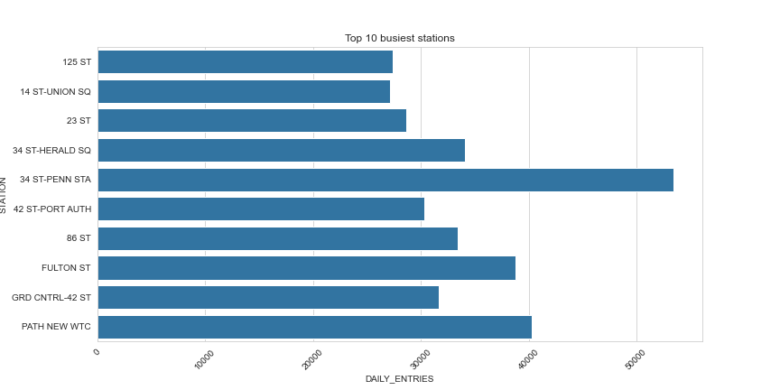
Top 10 busiest stations
The busiest station in NYC is 34 ST-PENN STA.
PATH NEW WTC
FULTON ST
34 ST-HERALD SQ
86 ST
GRD CNTRL-42 ST
42 ST-PROT AUTH
23 ST
14 ST-UNION SQ
125 ST

Slide 10
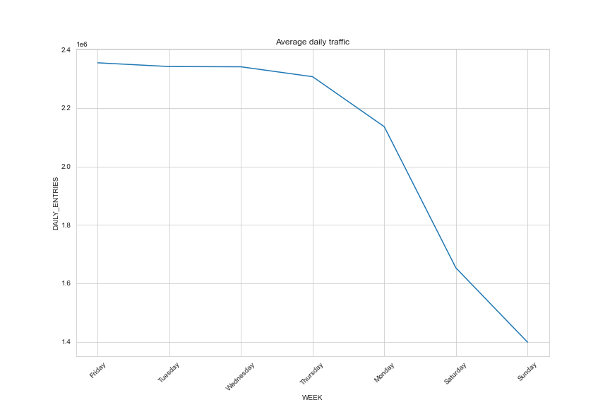
Data Visualization
Busiest Day of the week
The busiest two day of the week is Friday and Tuesday
And the least busy day is Sunday

Slide 11
Recommendation
From the analysis i recommend that the NYC Emergency Management deploy there staff and volunteers on Friday and Tuesday to the 10 busiest stations for the best target.

Slide 12
Thank you

